Slide 1
DataDash Marketing
Data driven and meaningful recommendations - Twitter
INNA BALOYAN
CHRISTINE CHYNOWETH
RIICHA MOHAN
SUPRIYA SATPATHY

Slide 2
OBJECTIVE
Analyze digital footprint of Influencers across 7 genres via Twitter metrics
Derive insights on Influencers’ actions or reactions to trending topics (Social vs Entertainment for today’s presentation)
Demonstrate the company’s bot at work
Notes:
Twitter is a valuable resource for marketing
Which influencer(s) (via twitter) would be most effective as a spokesperson for various marketing causes or products?
Analyze potential influencers for different marketing objectives
Compare tweet velocity with no. of followers
Using specific filters, who tweets about relevant topics

Slide 3
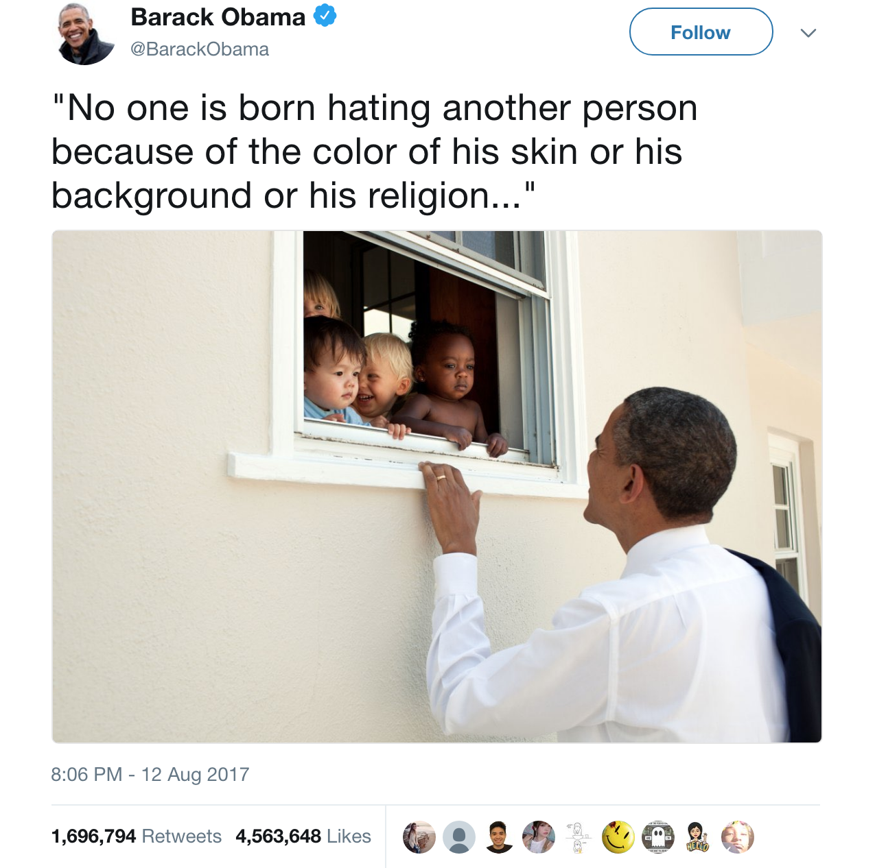
Most retweeted!

Slide 4
THE DATASET
Used Influencers Dataset, manually compiled by 7 genres
actors, comedians, economists, musicians, sports celebrities, social workers, and politicians
Chosen through Google and Twitter, based on their popularity, notoriety and our knowledge. Hand picked under 400 potential influencers in XLS file
Considered various datasets from kaggle.com, data.world, data.gov, but preferred to create the simple and universal data layout
allows DataDash clients the flexibility of choosing the influencers list themselves or/and pick any other genre/category for their potential influencer list
depends on clients’ marketing preferences
getting the best candidates for charity fundraising

Slide 5
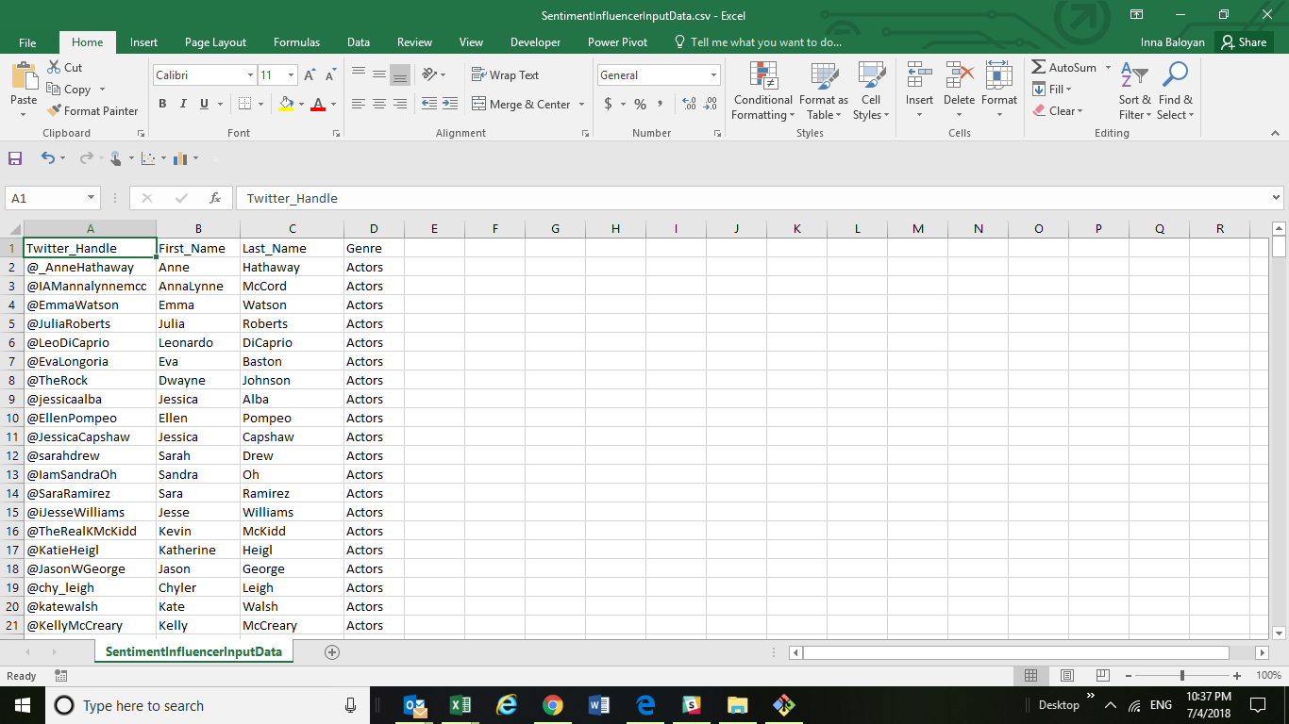

Slide 6
DATA CLEANING
Consolidated all genres potential Influencers records into one CSV file, and load it into Jupyter Notebook initial DataFrame
Used try-exception logic when making Tweepy API calls to get exceptions
Corrected spelling, spacing, incorrect data, etc.
Split cells into first name and last name
Chose filters such as, language, for tweet text analysis, but took into account all tweets and re-tweets
Later we could filter bots and other outliers
Considered current trends and influencers’ tweets

Slide 7
TRENDS
Considered what types of trending hashtags are influential on Twitter
Used few trend analysis sites, which show latest trends by hour and Twitter itself
https://trends24.in/united-states
https://www.hashtags.org
Manually assembled the trending hashtags by category types, “social” and “entertainment”, for this phase of the project
Later finding trends for any needed category could be automated within the code
Based on current trends, hashtags that fall under the “social” category include #FamiliesBelongTogether, #MeToo, and #WeCare. For the hashtags that fall under the “entertainment” category, there is #SocialMediaDay, #WorldCup, and #FIFA

Slide 8
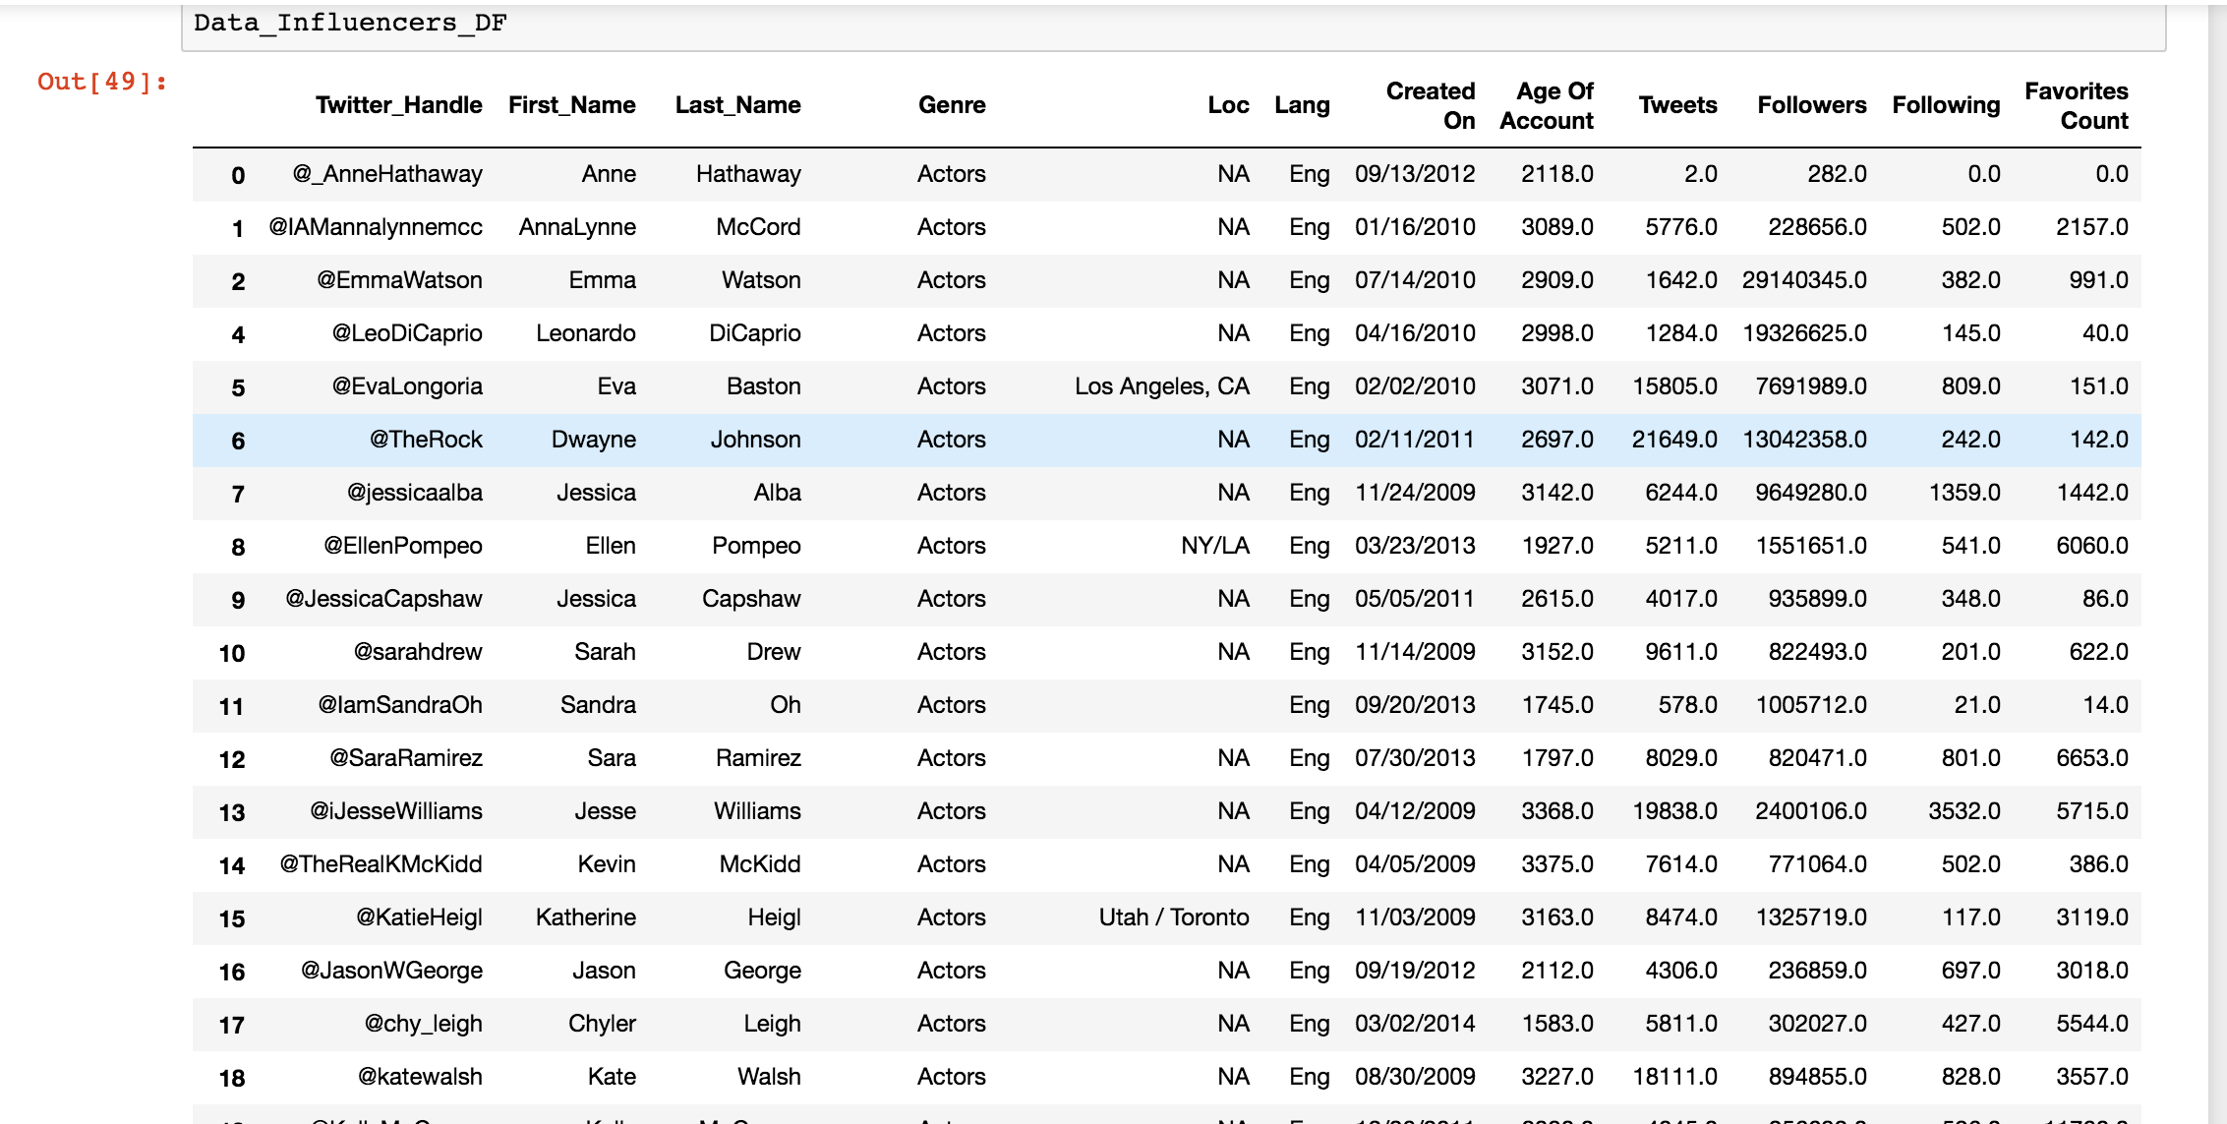

Slide 9
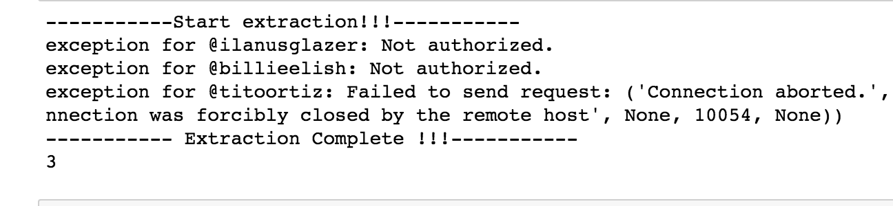

Slide 10
QUESTIONS
What are our Mission, Goals and Objectives.
Who has the most followers?
Who is the most positive influencer?
What genres of influencers achieve the greatest influence?
What types of trending hashtags are influential within these genres?
What are the top ten influencers based on the last year?

Slide 11
DATA ANALYSIS
Analyze the number of followers with number of tweets
Analyze the general sentiment of tweets over the last year
Which influencers are most ”influential”
Number of tweets
Number of followers

Slide 12
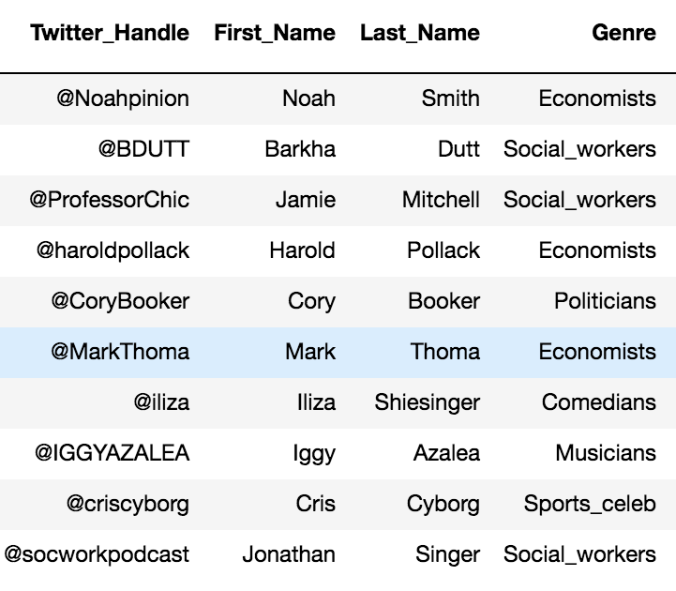
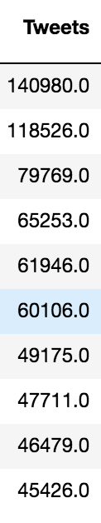
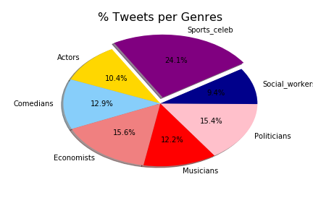
Tweets by Genre

Slide 13
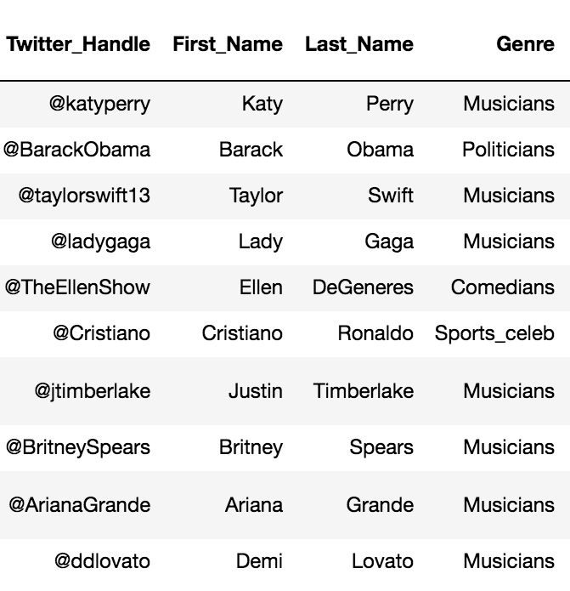
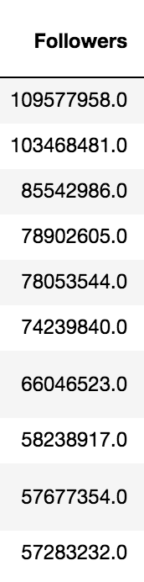
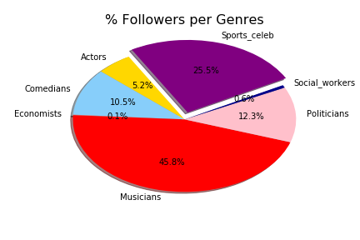
Followers by Genre

Slide 14
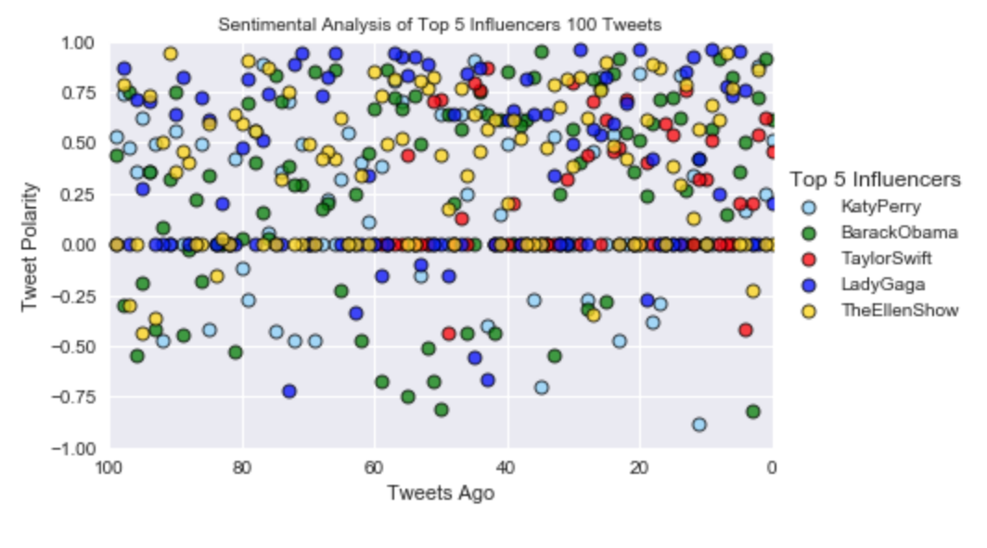
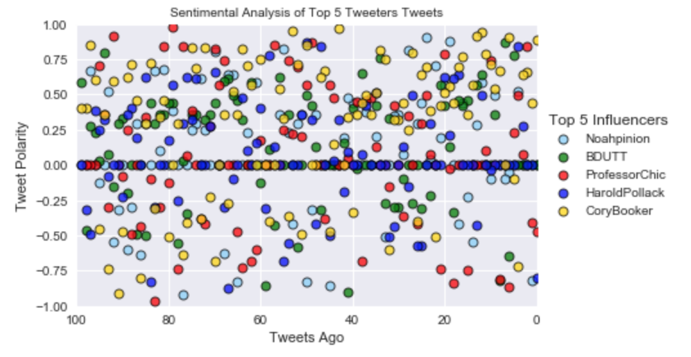

Slide 15
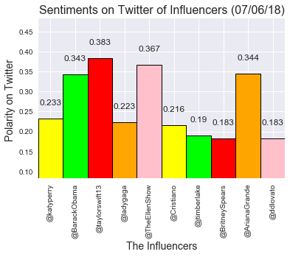
Sentiment Analysis - Influencers

Slide 16
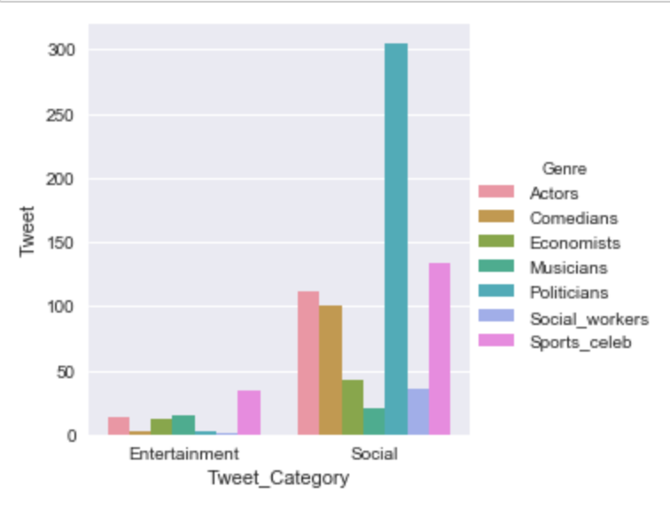
Tweet Category vs Number of Tweets

Slide 17
CONCLUSIONS
Sports celebrities is the most influential genre
Katy Perry is the biggest general influencer based on followers
Noah Smith is the biggest general influencer based on tweets
Which genre we want to target - how, why

Slide 18
TweetBot - TheDataDash1 /@Dash1The
Procfile defines the Worker as worker: python InfluencersBot.py
File that contains the environment details: tweepy==3.5.0 & pandas - Requirements.text
Config file: ConfigTweetBot.py contains API Credentials & Tokens.
InfluencersBot.py contains code in python.
Web Hosting done on Heroku.com
Infinite loop programmed to retweet @ specific time & on demand
Retweets the #tags of influencer’s organisation mission & goals

Slide 19
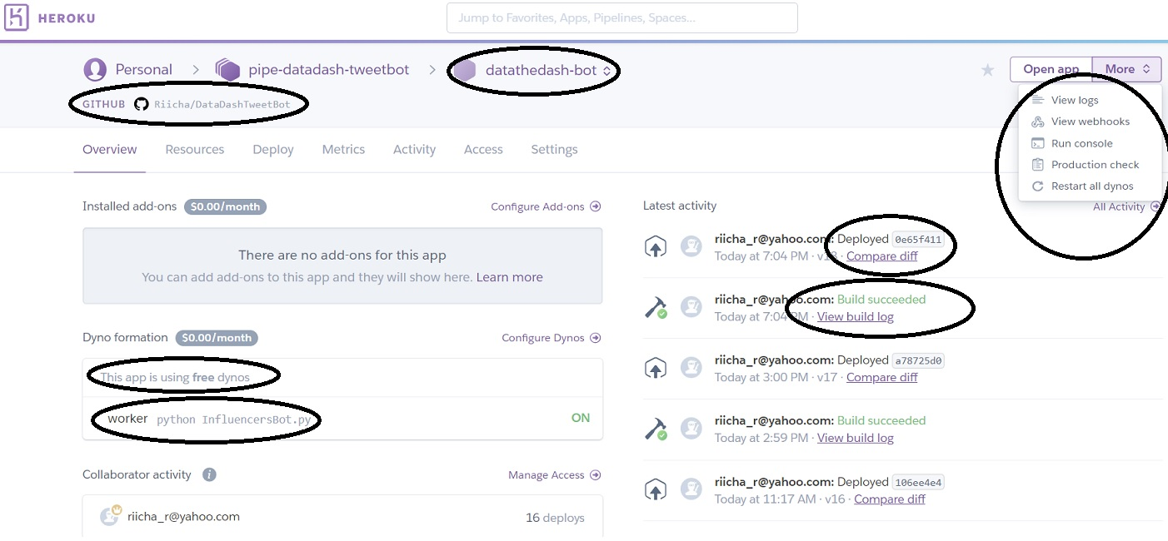

Slide 20
TweetBot @ Work
If any of these users….
@Riicha_r, @MonikerAsh, @ruchichandra26, @one171717, @IBaloyan, @KarnaniDeepa, @JAVillalbaUs, @JillStratton78, @JonathanGroth1, @data_stew, @Mike3dup, @TheRealAndrew19, @fervis_lauan, @TuerosVeronika, @pvenk14, @JingXu35625367, @MegNew2, @Pragati43524667, @WaqasIs69506672
Tweet with these hashtags...
#HarvardHealth, #WeightLoss, #Drug, #Medicine, #inflammation, #hcsm, #digitalhealth, #hcsmeu, #doctorsday, #NNM, #skincare, #pharmacy, #PlasticSurgery, #pharma, #ONC, #massagetherapy, #SelfCare, #KeepTalkingMH, #publichealth, #medicine, #SupportRadiopaedia, #AllTeachAllLearn, #patientcentric
TheDataDash1 will retweet it!!!

Slide 21
ROADMAP
Expansion to companies/brands/causes
Automate the data mining process
Expansion to other social media outlets
International analysis of influencers
Expand bot capabilities for marketing purposes
Notes:
Prototype of bot - can be customized to the needs of the client

Slide 22
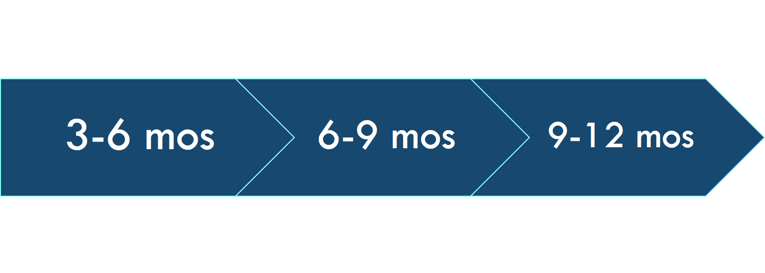
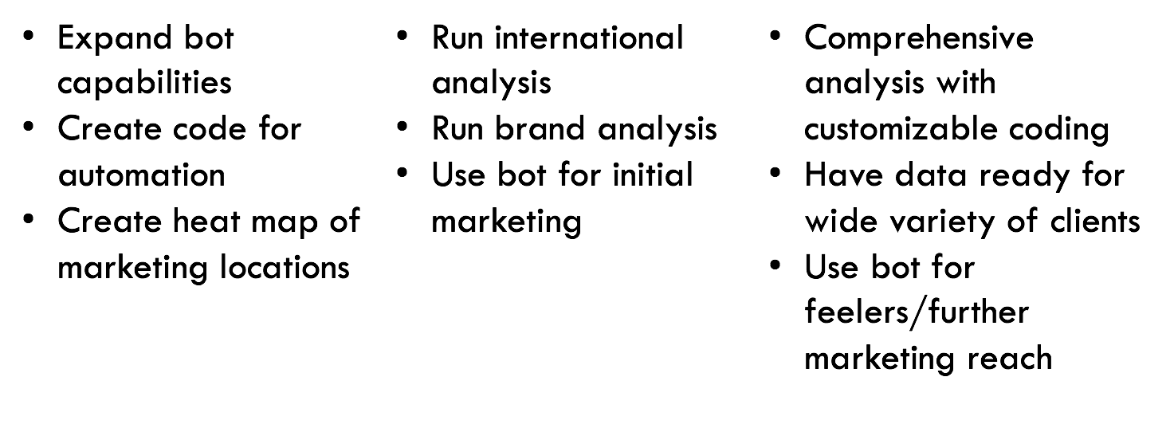
Notes:
Prototype of bot - can be customized to the needs of the client

Slide 23
Thank You!!!
Any Questions??
Notes:
Prototype of bot - can be customized to the needs of the client

